Slide 1
TRA expression in pancreatic cells

Slide 2
Recapitulation
Looking at
Looking for
Expression of pancreas-specific TRAs
In:
β-cells
Control: healthy pancreatic cells
Cytokine-treated: diabetes type 1 → cell death
PDAC cells
Control: cancer → cell proliferation
TBLX1 KO: decreased proliferation
TRAs suitable as
Biomarkers for PDAC
Cell fate indicators
Data Analysis Project: Carolyn Blümcke, Anna Boot, Selina Ernst, Bianca Greul

Slide 3
TRA gene expression matrix
0. Quality control of microarray chips: boxplots, scatterplots
Result: no chips discarded
1. Processing of raw expression values: normalization, background correction,
summary of probesets
Result: log2 transformed, over 90’000 transcripts
2. Transcripts into genes: translation, median fusion
Result: log2 transformed, over 18’000 genes
Data Analysis Project: Carolyn Blümcke, Anna Boot, Selina Ernst, Bianca Greul

Slide 4
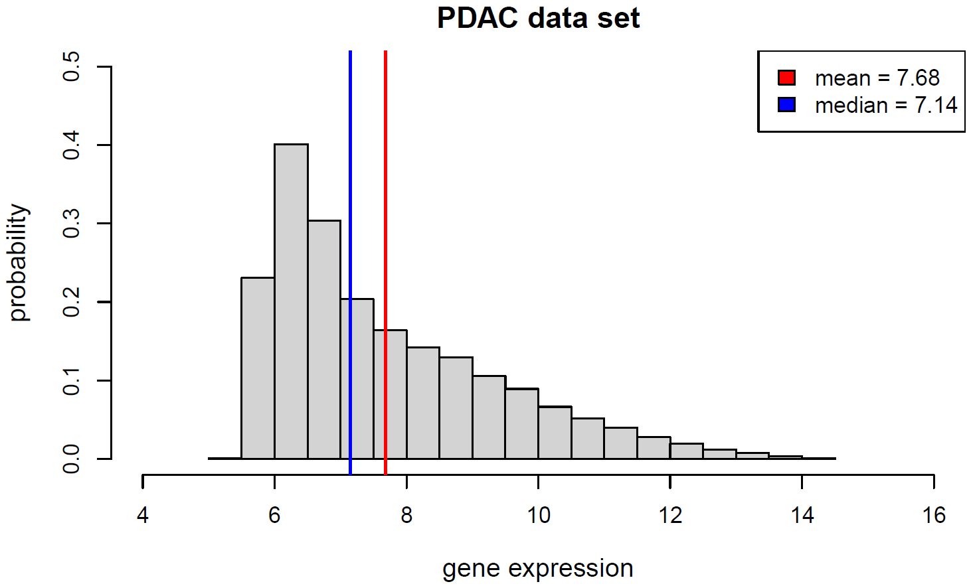
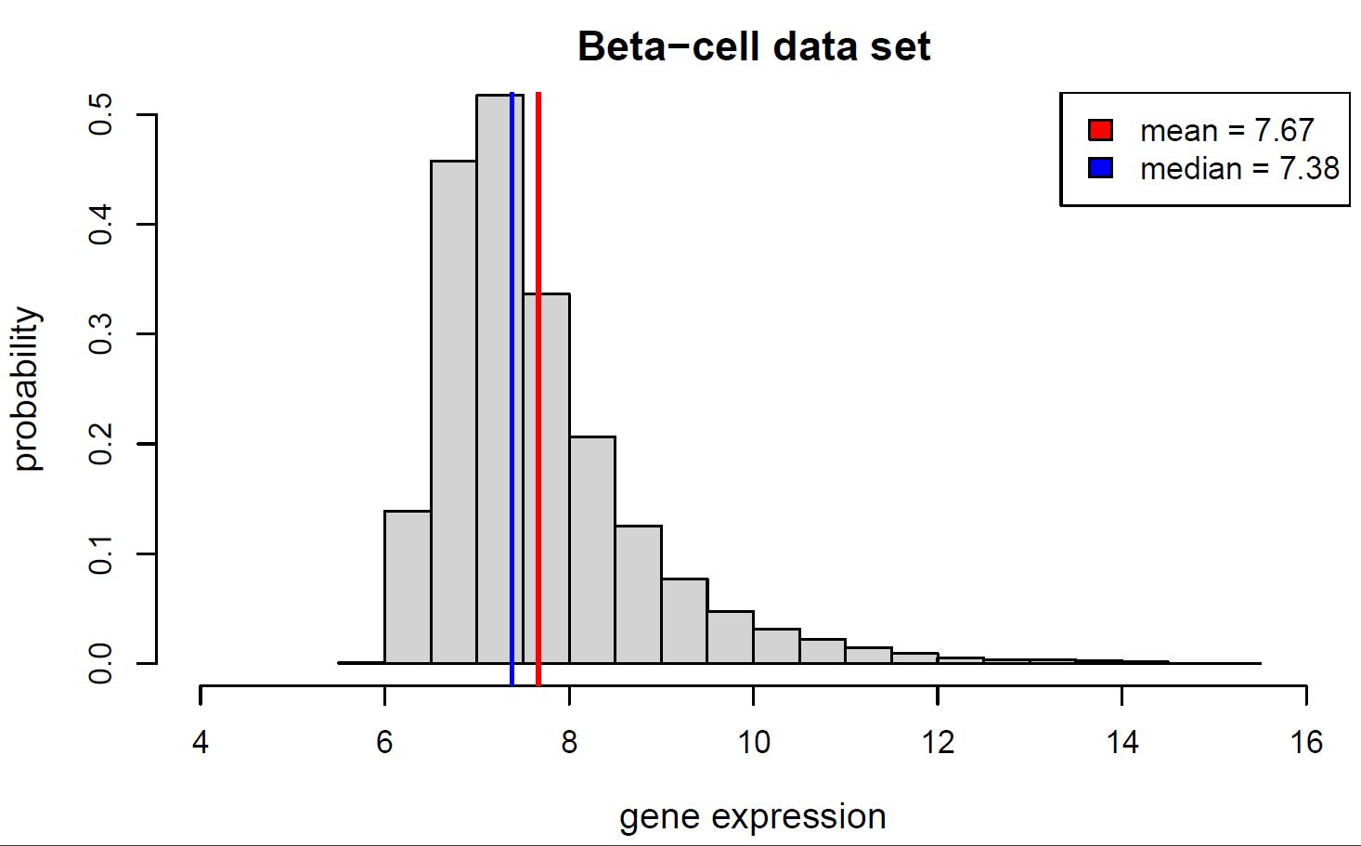
Distribution of gene expression
T-TEST
WILCOXON RANK SUM TEST
Data Analysis Project: Carolyn Blümcke, Anna Boot, Selina Ernst, Bianca Greul

Slide 5
TRA gene expression matrix
0. Quality control of microarray chips: boxplots, scatterplots
Result: no chips are discarded
1. Processing of raw expression values: normalization, background correction,
summary of probesets
Result: log2 transformed, over 90’000 transcripts
2. Transcripts into genes: translation, median
Result: log2 transformed, over 18’000 genes
3. Selecting TRA genes (original list of 330 genes)
Result: log2 transformed, 250 TRA genes
Data Analysis Project: Carolyn Blümcke, Anna Boot, Selina Ernst, Bianca Greul

Slide 6
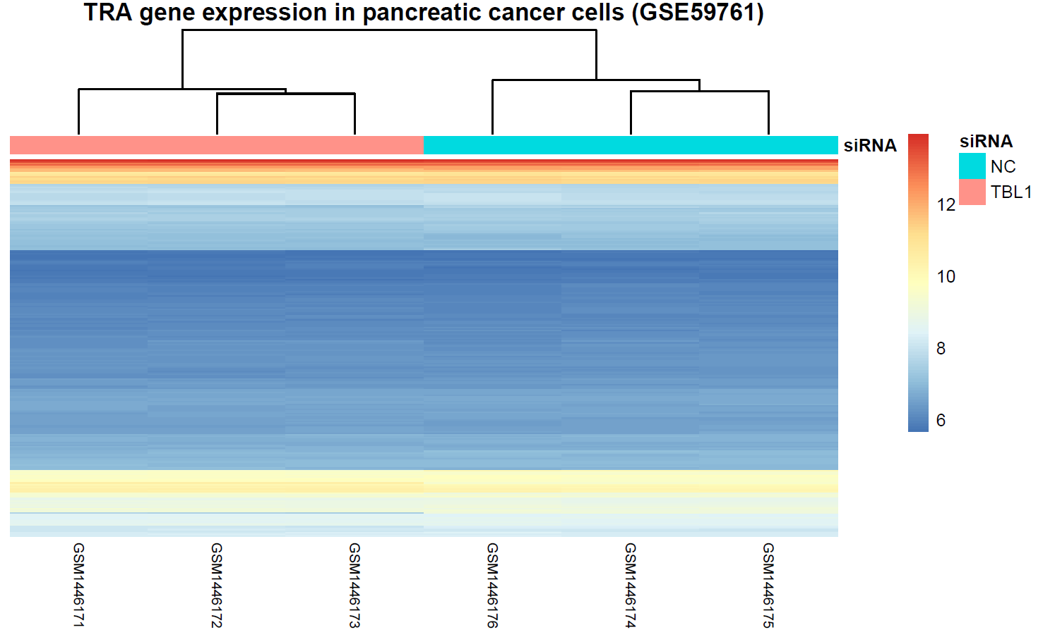
Subgroups PDAC-cells
Data Analysis Project: Carolyn Blümcke, Anna Boot, Selina Ernst, Bianca Greul

Slide 7
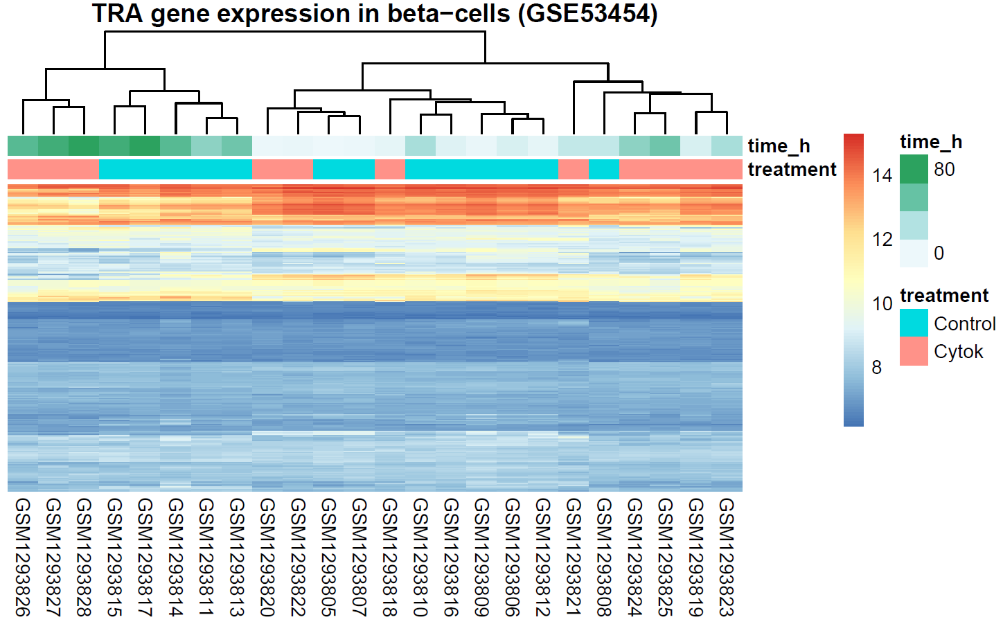
Subgroups beta-cells
Data Analysis Project: Carolyn Blümcke, Anna Boot, Selina Ernst, Bianca Greul

Slide 8
PDAC biomarkers

Slide 9
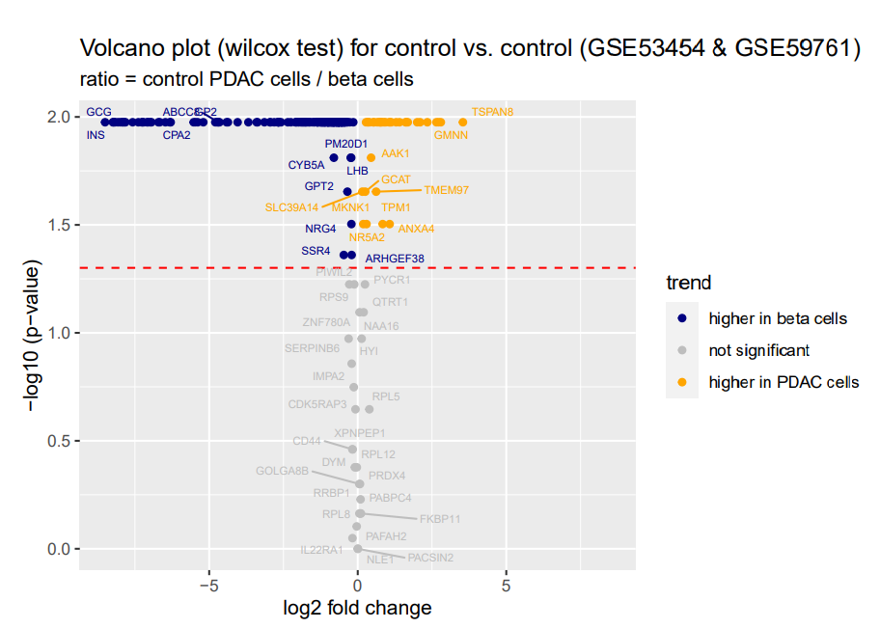
pDAC biomarkers
Problem:
Asymptomatic or unspecific symptoms
late diagnosis
→ high mortality
CA 19 -9
Most used biomarker
Low sensitivity and specificity
→ no universal screening tool
Differentially expressed TRAs: 225/250
Data Analysis Project: Carolyn Blümcke, Anna Boot, Selina Ernst, Bianca Greul

Slide 10
pDAC Biomarkers
TSPAN8
GMNN
Normally:
Overexpressed:
Intracellular signal transduction
regulates cell adhesion, proliferation and
differentiation
Progression and metastasis in several cancers
Regulation of DNA replication
Replication defects and genomic instability
Data Analysis Project: Carolyn Blümcke, Anna Boot, Selina Ernst, Bianca Greul

Slide 11
Cell fate indicators

Slide 12
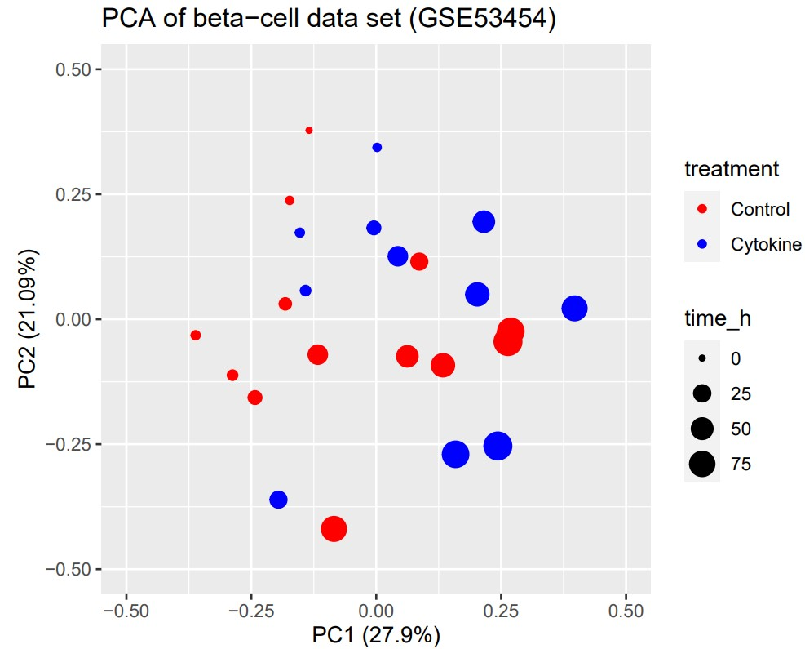
Time and cytokine influence
Data Analysis Project: Carolyn Blümcke, Anna Boot, Selina Ernst, Bianca Greul

Slide 13
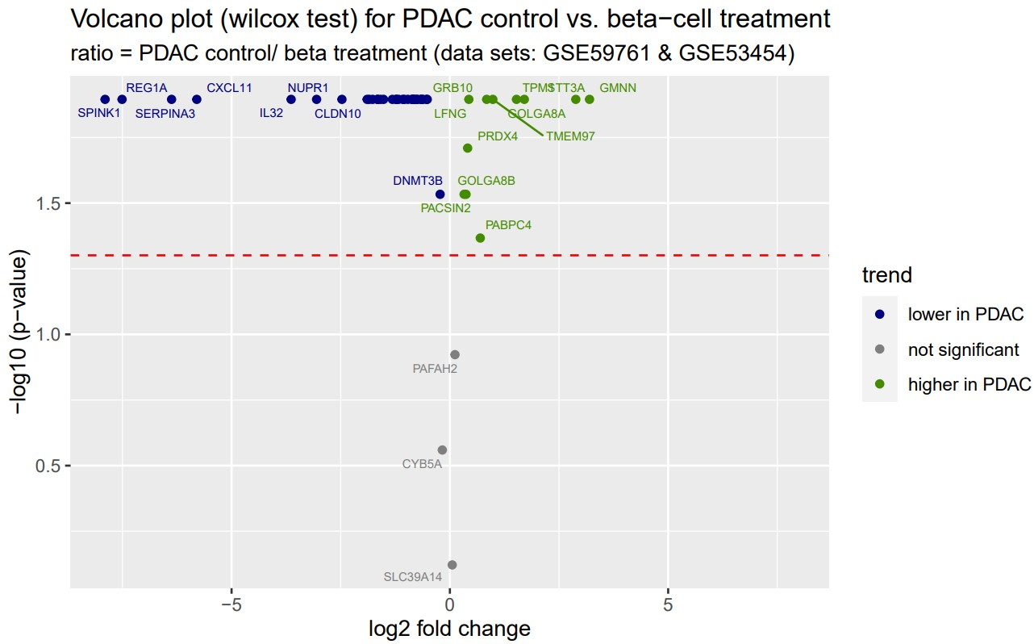
Cell fate indicators
GMNN:
Regulation of DNA replication
Overexpression linked to cancer
STT3A:
Subunit of OST
Upregulation of OST linked to immune evasion of tumor
Overexpression of GMNN and STT3A promote tumor growth
Data Analysis Project: Carolyn Blümcke, Anna Boot, Selina Ernst, Bianca Greul

Slide 14

Cell fate indicators
SPINK1:
Trypsin inhibitor
Associated with pancreatitis as well as diabetes and cancer
REG1A:
Islet regeneration and proliferation
Known for high expression in pancreatic cancer
Both genes are linked to cancer and therefore unsuitable
Data Analysis Project: Carolyn Blümcke, Anna Boot, Selina Ernst, Bianca Greul

Slide 15
Cell fate indicators
CXCL11:
Chemokine that induces inflammation
→ β-cell death
→ diabetes
Overexpression of CXCL11 induced diabetes type 1
Data Analysis Project: Carolyn Blümcke, Anna Boot, Selina Ernst, Bianca Greul

Slide 16
discussion

Slide 17
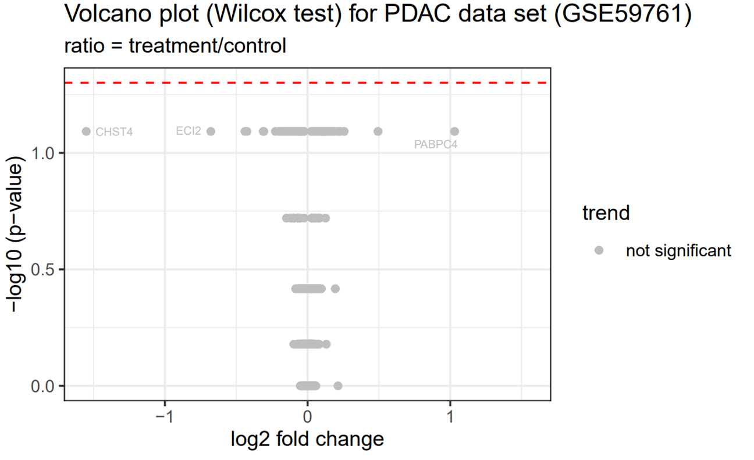
Discussion - problems
Differing TRA expression
Treatment protocol
Cell origin
Time in β-cell set
Combined expression values
Differences between transcripts
Protein isoforms
Small sample size in PDAC set
Undetected significant differences
Data Analysis Project: Carolyn Blümcke, Anna Boot, Selina Ernst, Bianca Greul

Slide 18
Discussion - outlook
PDAC biomarkers
Cell fate indicators
GMNN and TSPAN8
Expression in other tissues
Different PDAC cell lines
Tumor microenviroment
Specificity and sensitivity
Therapeutical target
STT3A and GMNN
Effects in cancer?
SPINK1 and REG1A
Cell death and proliferation
Intramolecular signaling pathways?
Data Analysis Project: Carolyn Blümcke, Anna Boot, Selina Ernst, Bianca Greul

